Slide 1
线性区域的分析及隐式正则化
许志钦
2023年11月10日

Slide 2
Linear Regime

Slide 3
T Luo#, ZQJ Xu#, Z Ma, Y Zhang*, Phase diagram for two-layer ReLU neural networks at infinite-width limit, JMLR, 2020

Slide 4
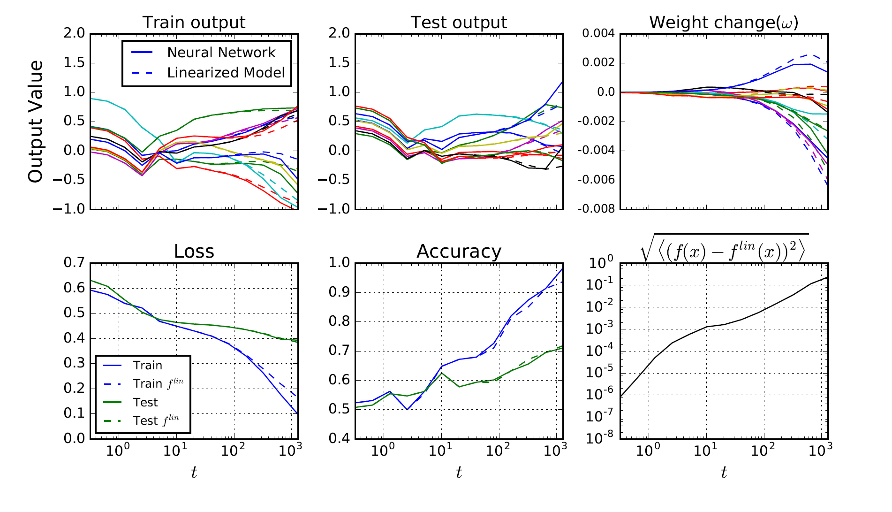
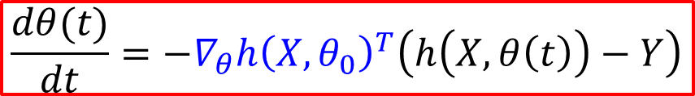
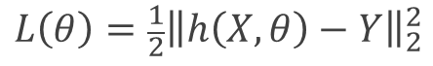
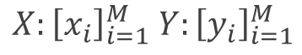
Linear approximation for wide NN
$h\left(x, θ(t)\right)=h\left(x,θ_{0}\right)+∇_{θ}h{\left(x,θ_{0}\right)}^{T}\left(θ\left(t\right)−θ_{0}\right)$ for any $t>0$
$$\frac{dθ(t)}{dt}=−∇_{θ}h{\left(X,θ_{0}\right)}^{T}\left(h\left(X,θ\left(t\right)\right)−Y\right)$$
$$L\left(θ\right)={\frac{1}{2}\left\|h\left(X,θ\right)−Y\right\|}_{2}^{2}$$
$$X:{\left[x_{i}\right]}_{i=1}^{M} Y:{\left[y_{i}\right]}_{i=1}^{M}$$
CIFAR 10, CNN
Lee et al., 2019

Slide 5
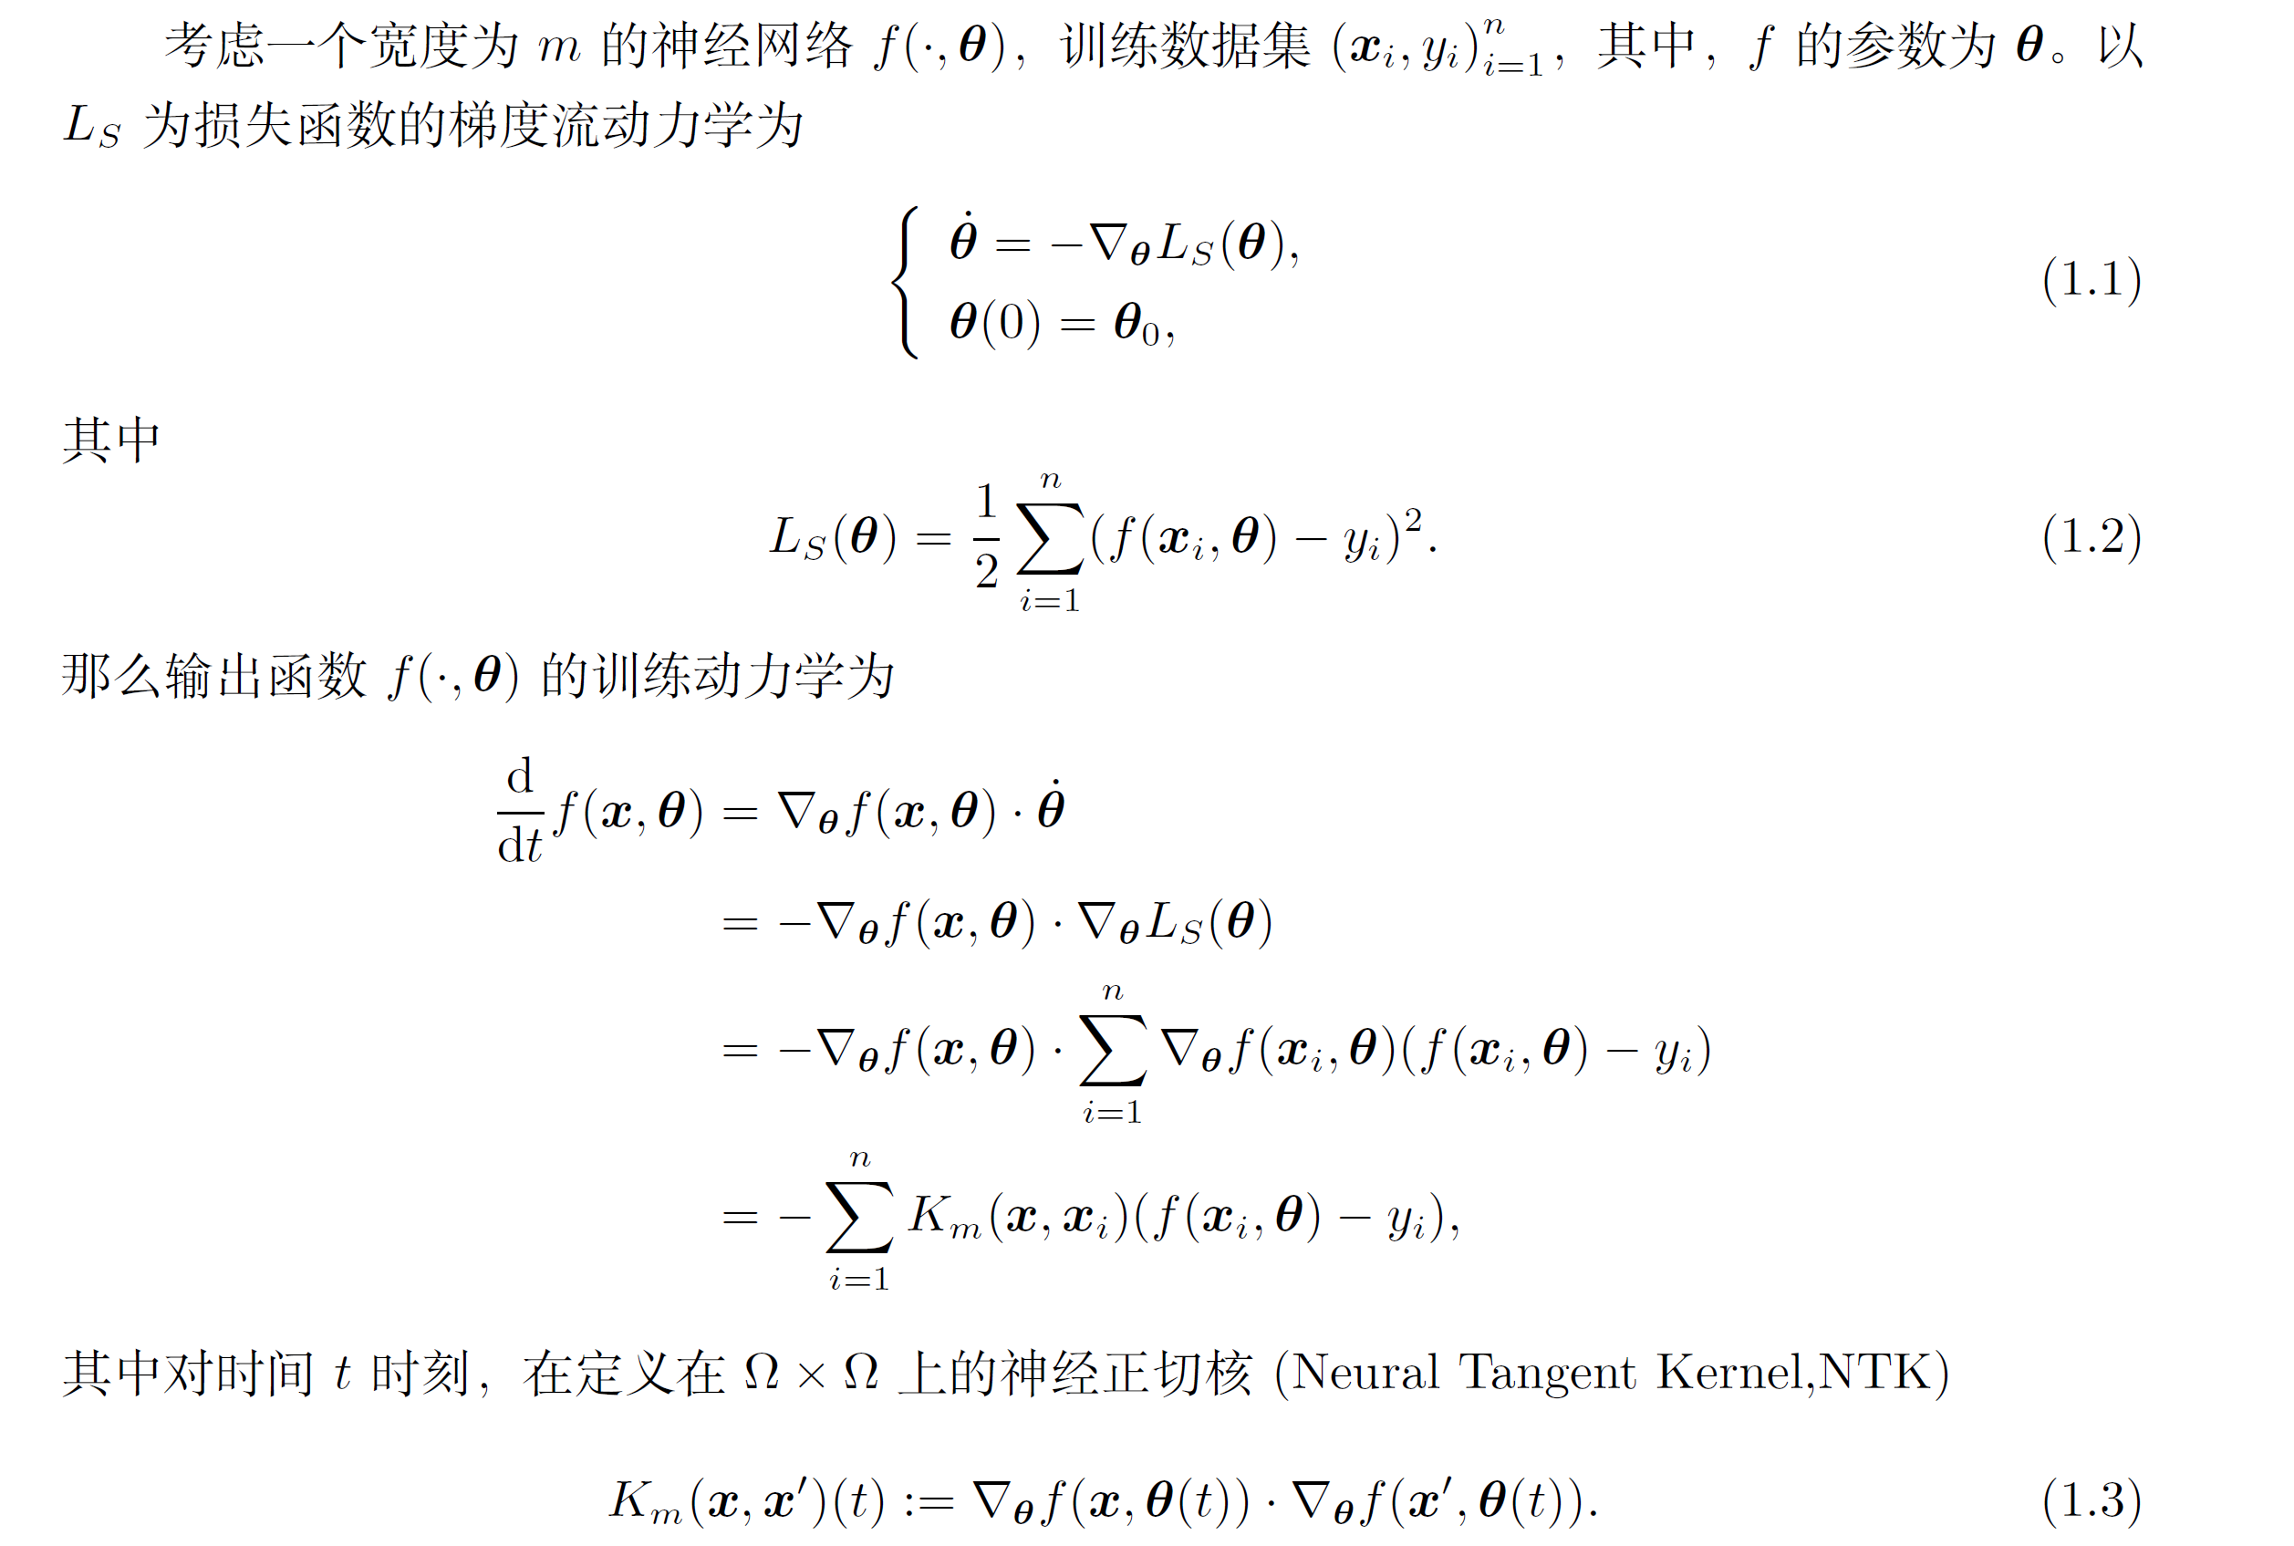
Zhi-Qin John Xu*, Yaoyu Zhang, Tao Luo, Overview frequency principle/spectral bias in deep learning. arxiv 2201.07395

Slide 6
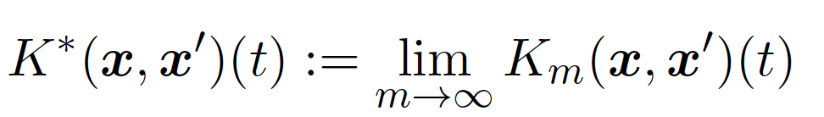
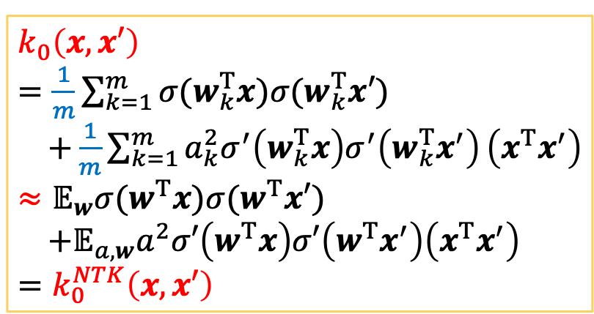
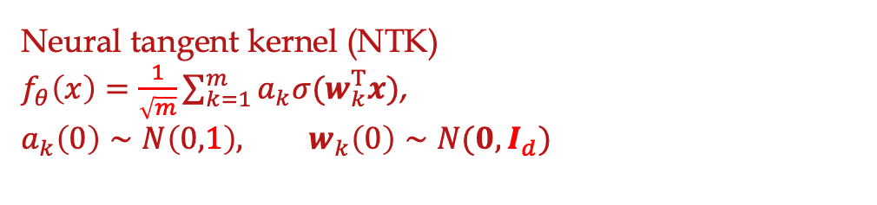
Neural tangent kernel (NTK)
$f_{θ}\left(x\right)=\frac{1}{\sqrt{m}}\sum_{k=1}^{m}{a_{k}σ(w_{k}^{T}x)}$,
$$a_{k}\left(0\right)∼N\left(0,1\right), w_{k}\left(0\right)∼N(0,I_{d})$$
$$k_{0}\left(x,x′\right)$$
$=\frac{1}{m}\sum_{k=1}^{m}{σ(w_{k}^{T}x)σ(w_{k}^{T}x′)}$ $+\frac{1}{m}\sum_{k=1}^{m}{a_{k}^{2}σ^{′}\left(w_{k}^{T}x\right)σ^{′}\left(w_{k}^{T}x^{′}\right)}\left(x^{T}x^{′}\right)$
$≈𝔼_{w}σ(w^{T}x)σ(w^{T}x′)$ $+𝔼_{a,w}a^{2}σ′\left(w^{T}x\right)σ′\left(w^{T}x^{′}\right)\left(x^{T}x^{′}\right)$
$$=k_{0}^{NTK}\left(x,x′\right)$$
NTK theorem, Jacot et al., 2018

Slide 7
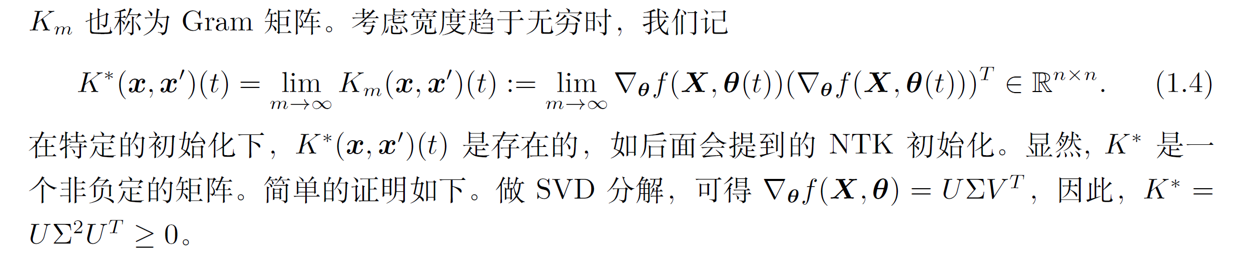
Zhi-Qin John Xu*, Yaoyu Zhang, Tao Luo, Overview frequency principle/spectral bias in deep learning. arxiv 2201.07395

Slide 8
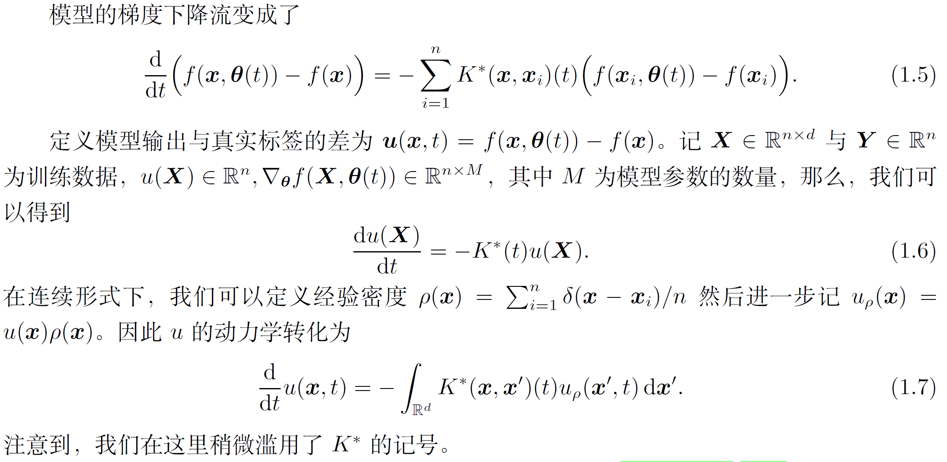
Zhi-Qin John Xu*, Yaoyu Zhang, Tao Luo, Overview frequency principle/spectral bias in deep learning. arxiv 2201.07395

Slide 9
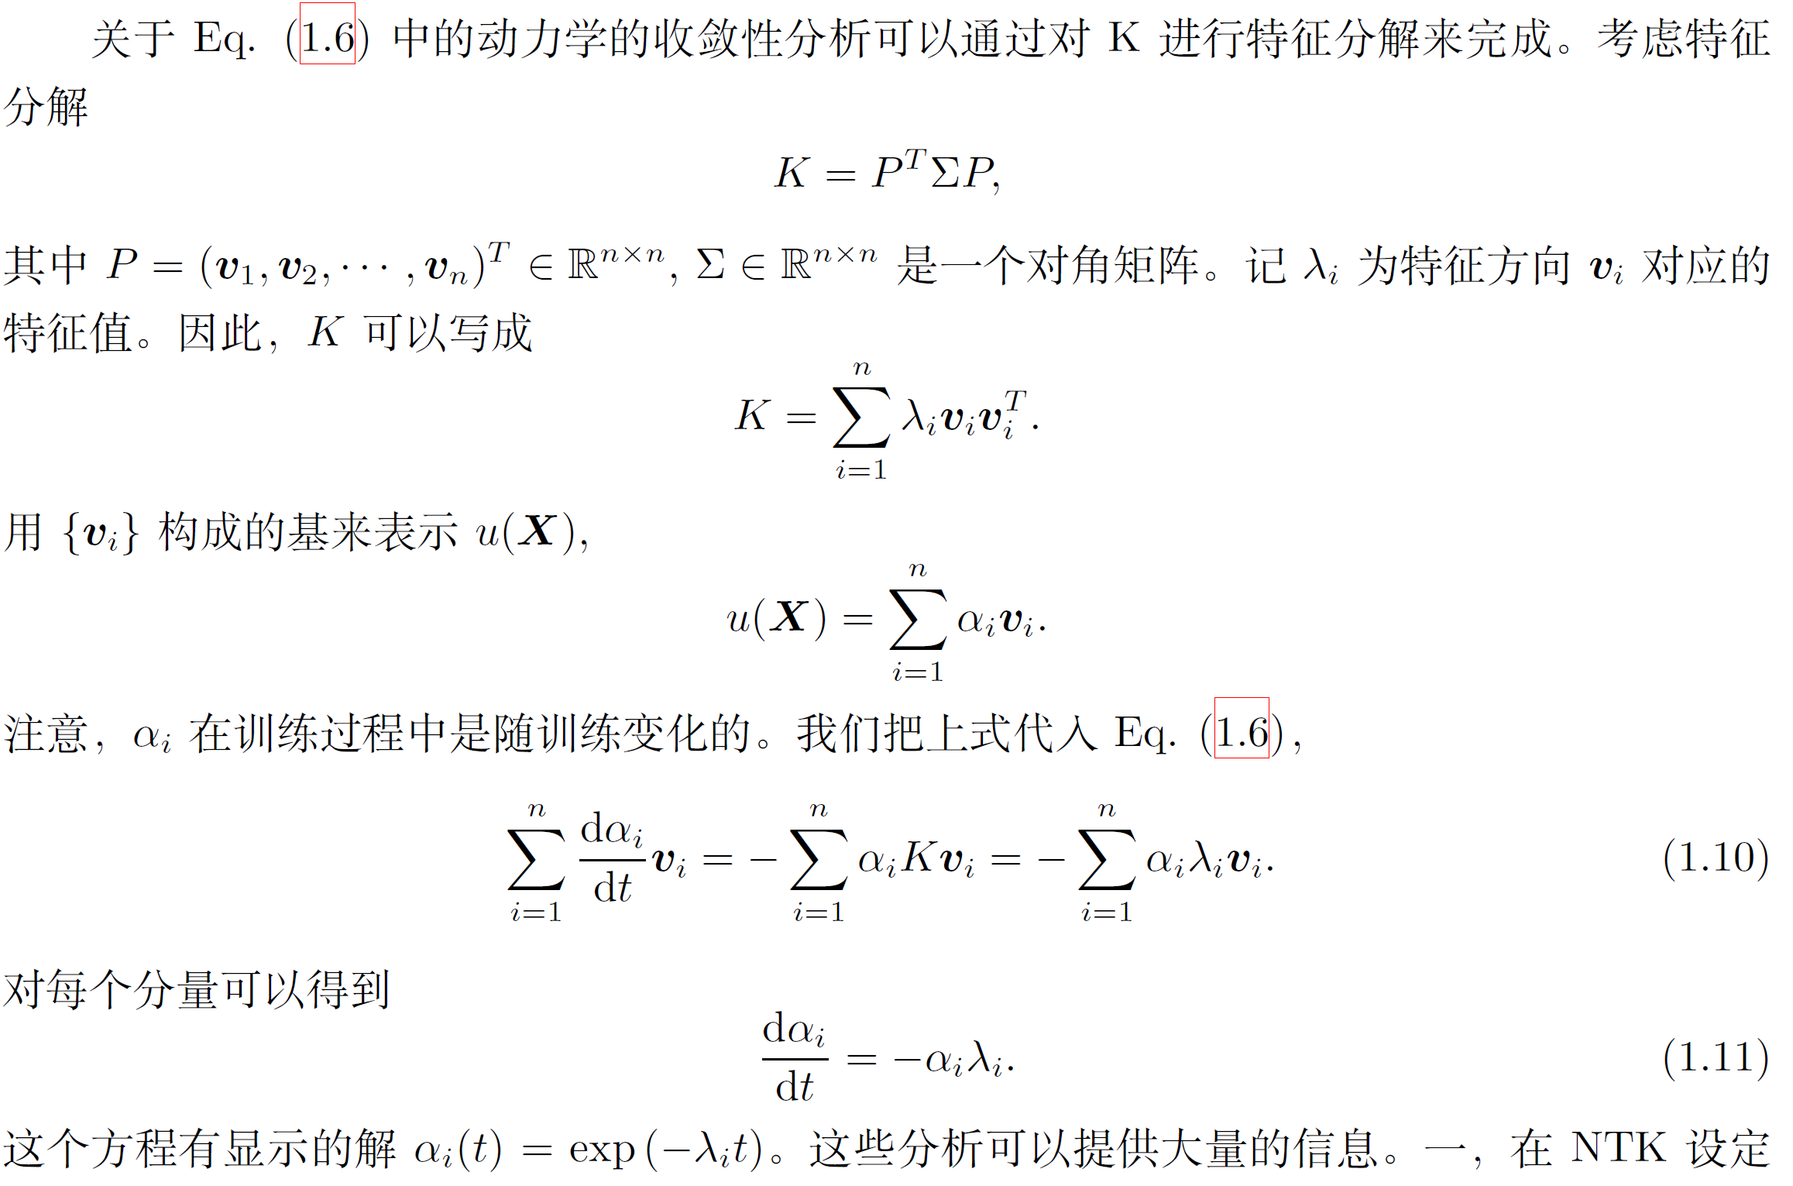
Zhi-Qin John Xu*, Yaoyu Zhang, Tao Luo, Overview frequency principle/spectral bias in deep learning. arxiv 2201.07395

Slide 10
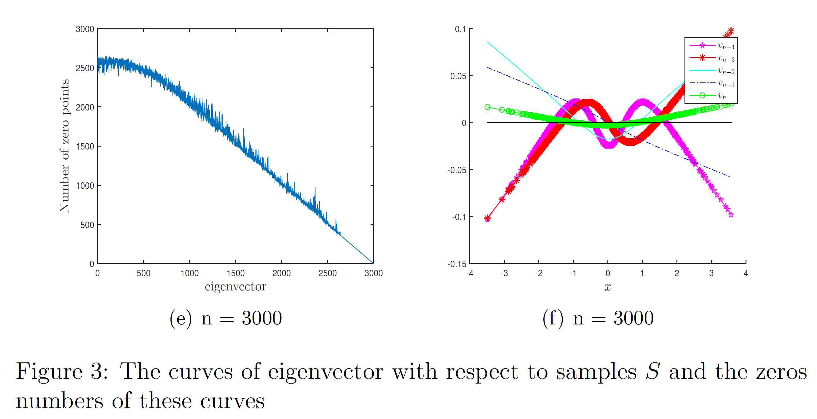
Gram matrix
Zhi-Qin John Xu*, Yaoyu Zhang, Tao Luo, Overview frequency principle/spectral bias in deep learning. arxiv 2201.07395

Slide 11
Linear Frequency Principle
Yaoyu Zhang, Tao Luo, Zheng Ma, Zhi-Qin John Xu*, Linear Frequency Principle Model to Understand the Absence of Overfitting in Neural Networks. Chinese Physics Letters, 2021
Tao Luo*, Zheng Ma, Zhi-Qin John Xu, Yaoyu Zhang, On the exact computation of linear frequency principle dynamics and its generalization, SIAM Journal on Mathematics of Data Science (SIMODS 2022), arxiv 2010.08153
Tao Luo*, Zheng Ma, Zhiwei Wang, Zhi-Qin John Xu, Yaoyu Zhang, An Upper Limit of Decaying Rate with Respect to Frequency in Deep Neural Network, To appear in Mathematical and Scientific Machine Learning 2022 (MSML22)

Slide 12
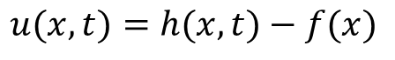
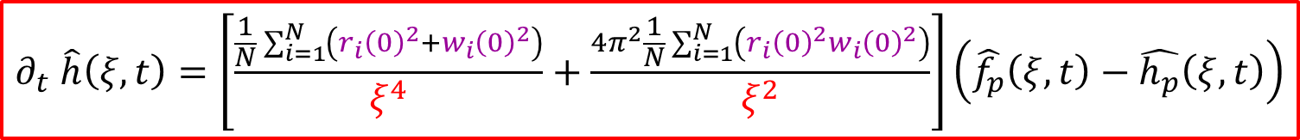
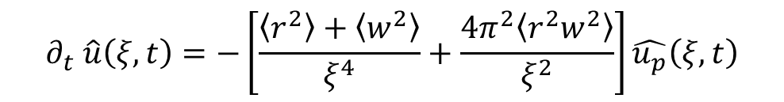
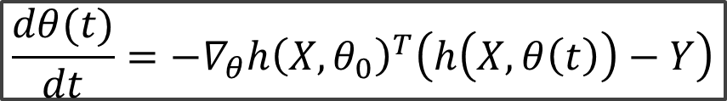
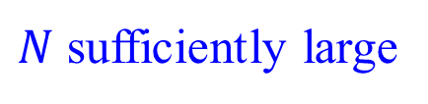
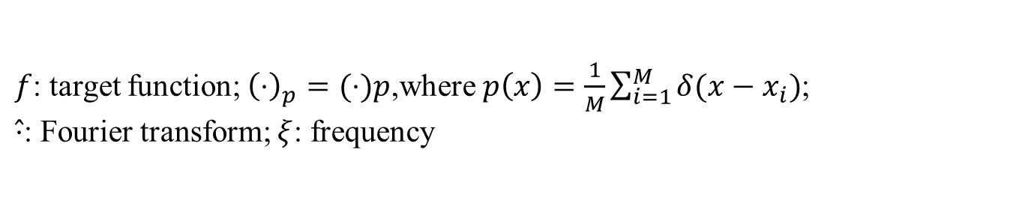
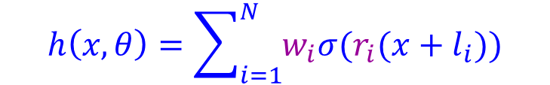
Linear F-Principle dynamics
$$\frac{dθ(t)}{dt}=−∇_{θ}h{\left(X,θ_{0}\right)}^{T}\left(h\left(X,θ\left(t\right)\right)−Y\right)$$
$$h\left(x,θ\right)=\sum_{i=1}^{N}{w_{i}σ(r_{i}(x+l_{i}))}$$
1-d function
$N$ sufficiently large
$$∂_{t} \hat{h}\left(ξ,t\right)=\left[\frac{\frac{1}{N}\sum_{i=1}^{N}{\left(r_{i}{\left(0\right)}^{2}+w_{i}{\left(0\right)}^{2}\right)}}{ξ^{4}}+\frac{4π^{2}\frac{1}{N}\sum_{i=1}^{N}{\left(r_{i}{\left(0\right)}^{2}w_{i}{\left(0\right)}^{2}\right)}}{ξ^{2}}\right]\left(\hat{f_{p}}\left(ξ,t\right)−\hat{h_{p}}\left(ξ,t\right)\right)$$
$f$: target function; ${\left(⋅\right)}_{p}=(⋅)p$,where$p\left(x\right)=\frac{1}{M}\sum_{i=1}^{M}{δ(x−x_{i})}$;
$\hat{⋅}$: Fourier transform; $ξ$: frequency
For simplicity
$$∂_{t} \hat{u}\left(ξ,t\right)=−\left[\frac{\left\langle r^{2}\right\rangle +\left\langle w^{2}\right\rangle }{ξ^{4}}+\frac{4π^{2}\left\langle r^{2}w^{2}\right\rangle }{ξ^{2}}\right]\hat{u_{p}}\left(ξ,t\right)$$
$$u(x,t)=h(x,t)−f(x)$$
Yaoyu Zhang, Tao Luo, Zheng Ma, Zhi-Qin John Xu*, Linear Frequency Principle Model to Understand the Absence of Overfitting in Neural Networks. Chinese Physics Letters, 2021
Tao Luo*, Zheng Ma, Zhi-Qin John Xu, Yaoyu Zhang, On the exact computation of linear frequency principle dynamics and its generalization, SIAM Journal on Mathematics of Data Science (SIMODS 2022)

Slide 13
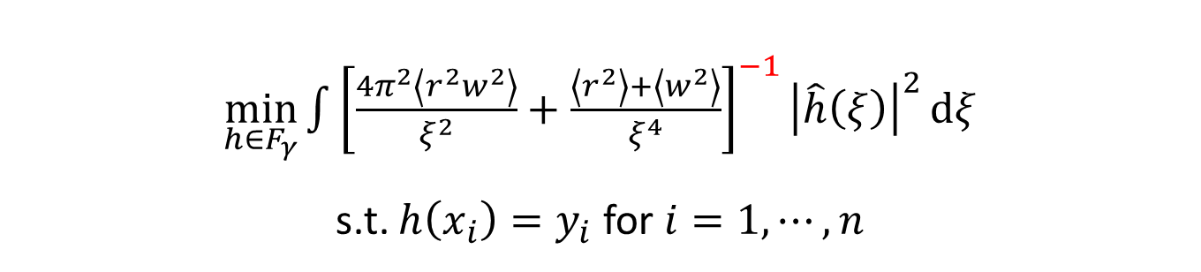
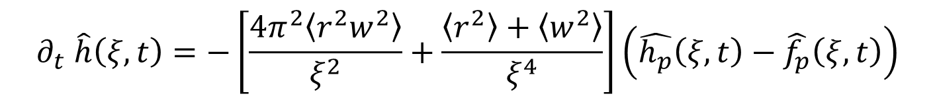
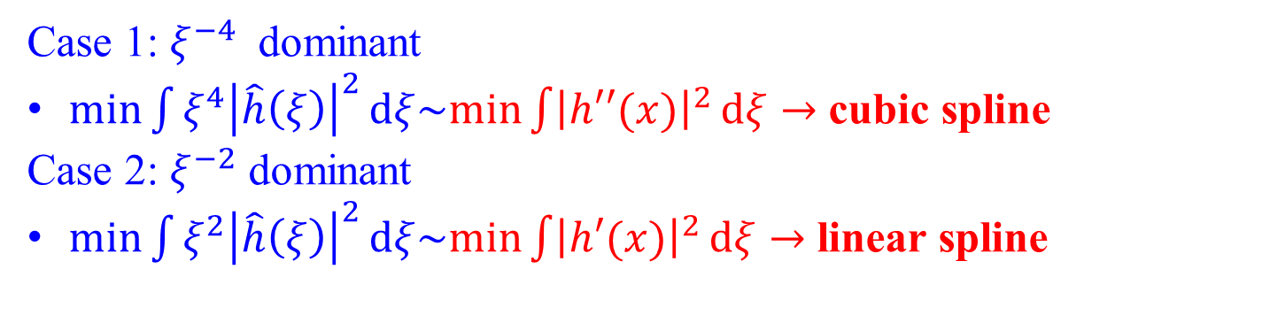
Preference induced by LFP dynamics
$$∂_{t} \hat{h}\left(ξ,t\right)=−\left[\frac{4π^{2}\left\langle r^{2}w^{2}\right\rangle }{ξ^{2}}+\frac{\left\langle r^{2}\right\rangle +\left\langle w^{2}\right\rangle }{ξ^{4}}\right]\left(\hat{h_{p}}\left(ξ,t\right)−\hat{f_{p}}\left(ξ,t\right)\right)$$
$\min_{h∈F_{γ}}{\int{{\left[\frac{4π^{2}\left\langle r^{2}w^{2}\right\rangle }{ξ^{2}}+\frac{\left\langle r^{2}\right\rangle +\left\langle w^{2}\right\rangle }{ξ^{4}}\right]}^{−1}{\left|\hat{h}\left(ξ\right)\right|}^{2}}}dξ$
s.t. $h\left(x_{i}\right)=y_{i}$ for $i=1,⋯,n$
low frequency preference
Case 1: $ξ^{−4}$ dominant
$min\int{ξ^{4}{\left|\hat{h}\left(ξ\right)\right|}^{2}}dξ\sim min\int{{\left|h′′(x)\right|}^{2}}dξ→$ cubic spline
Case 2: $ξ^{−2}$ dominant
$min\int{ξ^{2}{\left|\hat{h}\left(ξ\right)\right|}^{2}}dξ\sim min\int{{\left|h′(x)\right|}^{2}}dξ→$ linear spline
Yaoyu Zhang, Tao Luo, Zheng Ma, Zhi-Qin John Xu*, Linear Frequency Principle Model to Understand the Absence of Overfitting in Neural Networks. Chinese Physics Letters, 2021
Tao Luo*, Zheng Ma, Zhi-Qin John Xu, Yaoyu Zhang, On the exact computation of linear frequency principle dynamics and its generalization, SIAM Journal on Mathematics of Data Science (SIMODS 2022)

Slide 14
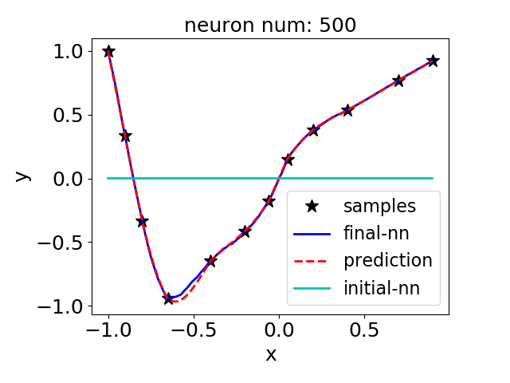
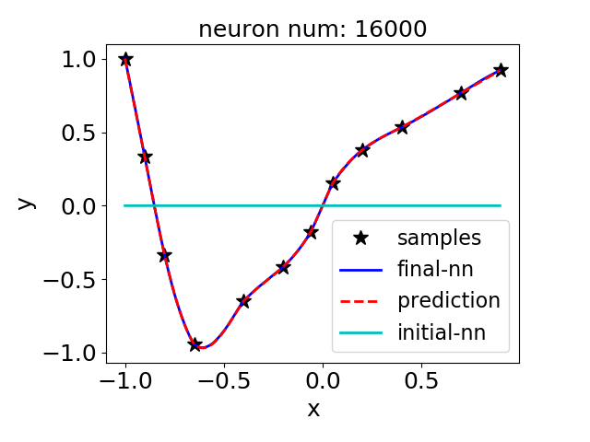
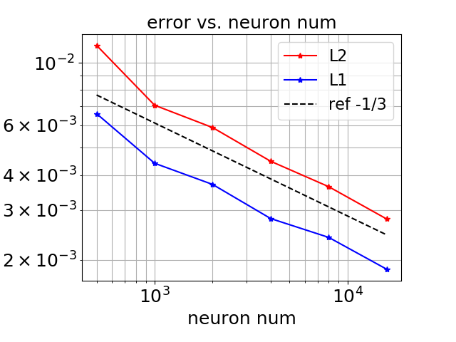
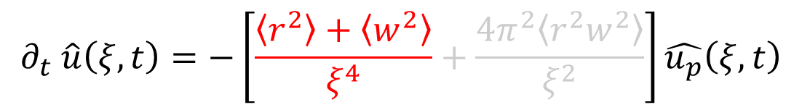
Two-layer relu-NN
$$∂_{t} \hat{u}\left(ξ,t\right)=−\left[\frac{\left\langle r^{2}\right\rangle +\left\langle w^{2}\right\rangle }{ξ^{4}}+\frac{4π^{2}\left\langle r^{2}w^{2}\right\rangle }{ξ^{2}}\right]\hat{u_{p}}\left(ξ,t\right)$$
w and r are initialized by uniform distributions on [ -0.1,0.1 ] and [ -0.25,0.25 ]
Yaoyu Zhang, Tao Luo, Zheng Ma, Zhi-Qin John Xu*, Linear Frequency Principle Model to Understand the Absence of Overfitting in Neural Networks. Chinese Physics Letters, 2021
Tao Luo*, Zheng Ma, Zhi-Qin John Xu, Yaoyu Zhang, On the exact computation of linear frequency principle dynamics and its generalization, SIAM Journal on Mathematics of Data Science (SIMODS 2022)

Slide 15
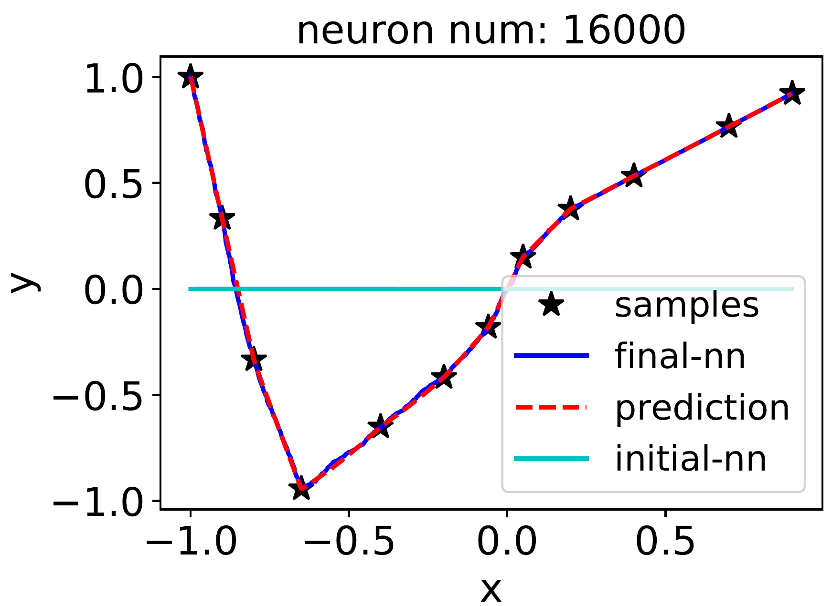
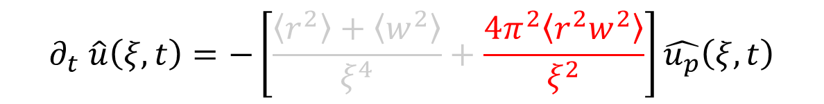
Two-layer relu-NN
$$∂_{t} \hat{u}\left(ξ,t\right)=−\left[\frac{\left\langle r^{2}\right\rangle +\left\langle w^{2}\right\rangle }{ξ^{4}}+\frac{4π^{2}\left\langle r^{2}w^{2}\right\rangle }{ξ^{2}}\right]\hat{u_{p}}\left(ξ,t\right)$$
w and r are initialized by uniform distributions on [ -2,2]
Yaoyu Zhang, Tao Luo, Zheng Ma, Zhi-Qin John Xu*, Linear Frequency Principle Model to Understand the Absence of Overfitting in Neural Networks. Chinese Physics Letters, 2021
Tao Luo*, Zheng Ma, Zhi-Qin John Xu, Yaoyu Zhang, On the exact computation of linear frequency principle dynamics and its generalization, SIAM Journal on Mathematics of Data Science (SIMODS 2022)

Slide 16
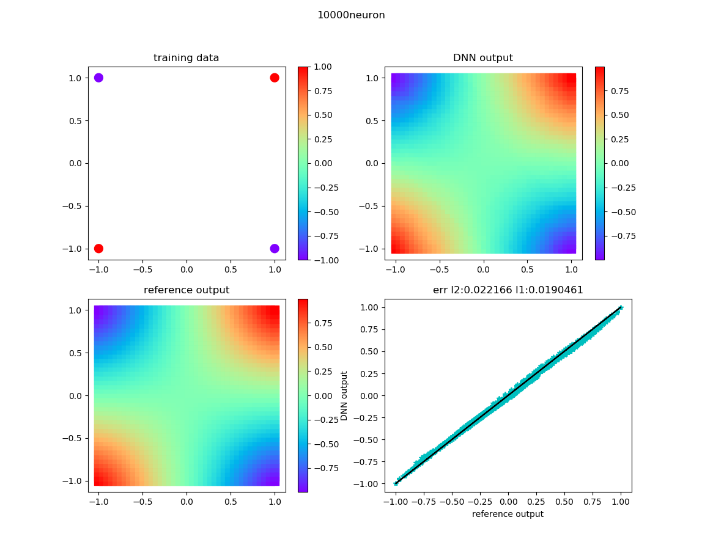

High-dim case
$$∂_{t} \hat{u}\left(ξ,t\right)=−\left[\frac{\left\langle {\left|r\right|}^{2}\right\rangle +\left\langle w^{2}\right\rangle }{ξ^{d+3}}+\frac{4π^{2}\left\langle {\left|r\right|}^{2}w^{2}\right\rangle }{ξ^{d+1}}\right]\hat{u_{p}}\left(ξ,t\right)$$
Yaoyu Zhang, Tao Luo, Zheng Ma, Zhi-Qin John Xu*, Linear Frequency Principle Model to Understand the Absence of Overfitting in Neural Networks. Chinese Physics Letters, 2021
Tao Luo*, Zheng Ma, Zhi-Qin John Xu, Yaoyu Zhang, On the exact computation of linear frequency principle dynamics and its generalization, SIAM Journal on Mathematics of Data Science (SIMODS 2022)

Slide 17
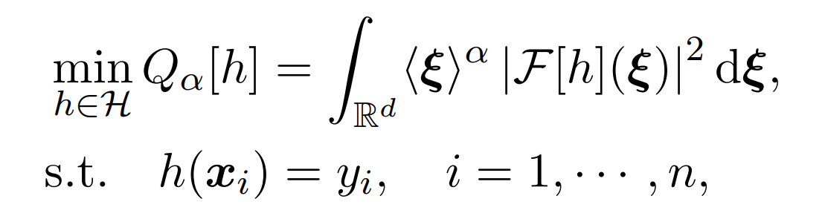
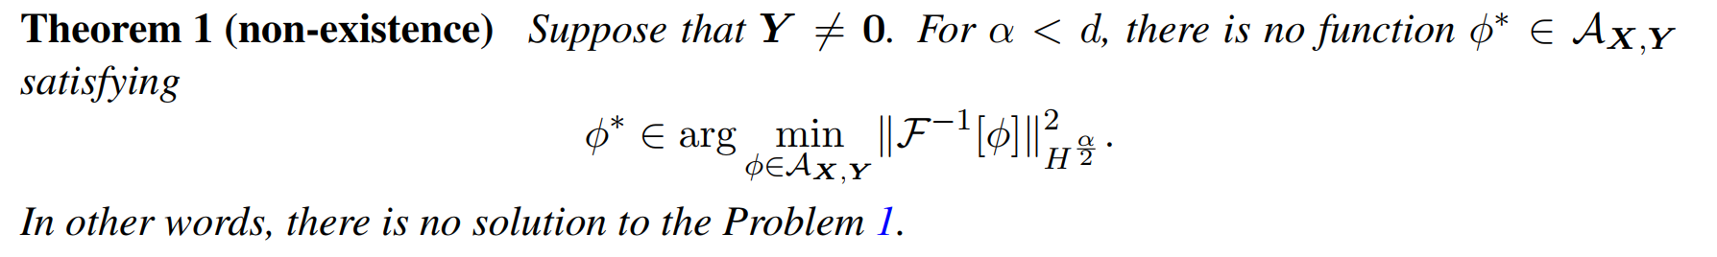
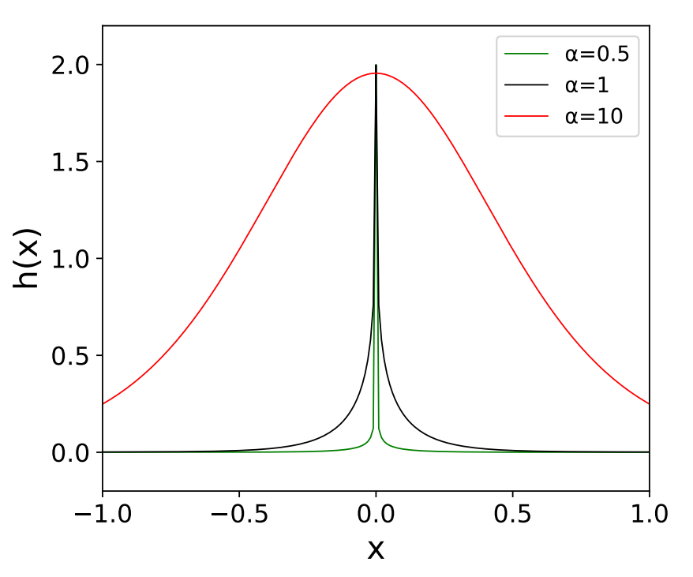
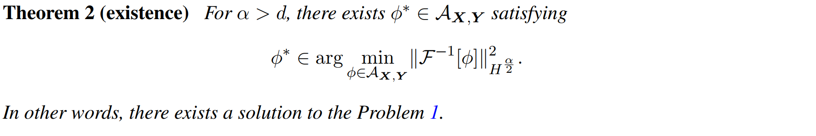
Limit of the frequency bias
Tao Luo*, Zheng Ma, Zhiwei Wang, Zhi-Qin John Xu, Yaoyu Zhang, An Upper Limit of Decaying Rate with Respect to Frequency in Deep Neural Network, To appear in Mathematical and Scientific Machine Learning 2022 (MSML22)

Slide 18
Implicit Bias
Yaoyu Zhang, Zhi-Qin John Xu* , Tao Luo, Zheng Ma, A type of generalization error induced by initialization in deep neural networks. arXiv preprint: 1905.07777 (2019), 1st Mathematical and Scientific Machine Learning Conference (MSML2020).

Slide 19
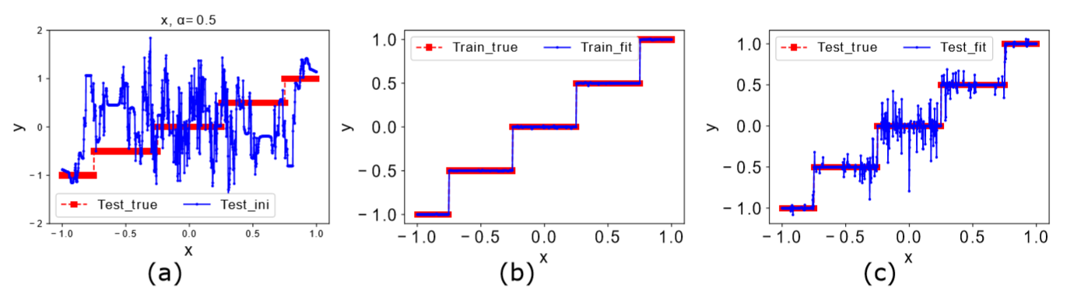
Impact of initialization in experiments
initial
train
test
Overfit!
Xu, et al., ICONIP 2019

Slide 20
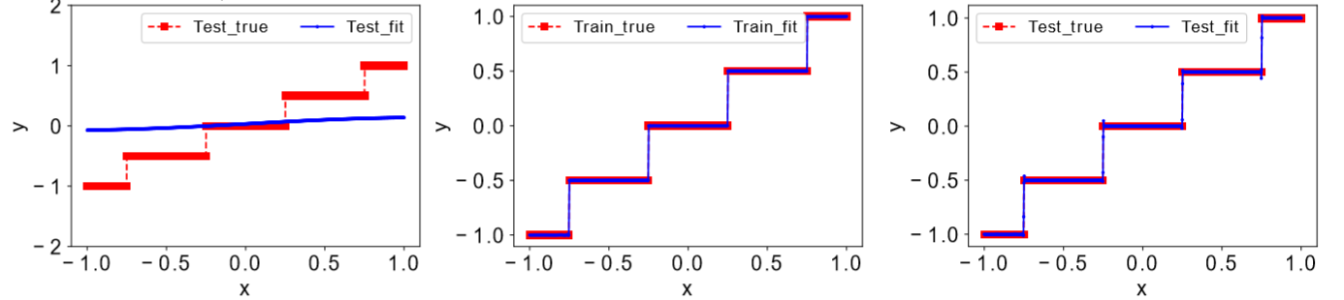
Impact of initialization in experiments
initial
train
test
Generalize well
Xu, et al., ICONIP 2019

Slide 21
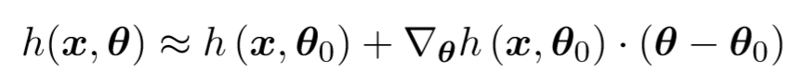
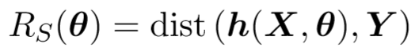
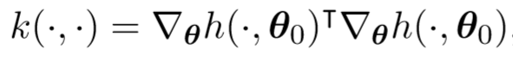
Setup in the NTK regime
NNs can be linearized around initialization
Loss
Neural tangent kernel (NTK)
Kernel gradient flow
Yaoyu Zhang, Zhi-Qin John Xu* , Tao Luo, Zheng Ma, A type of generalization error induced by initialization in deep neural networks. arXiv preprint: 1905.07777 (2019), 1st Mathematical and Scientific Machine Learning Conference (MSML2020).

Slide 22
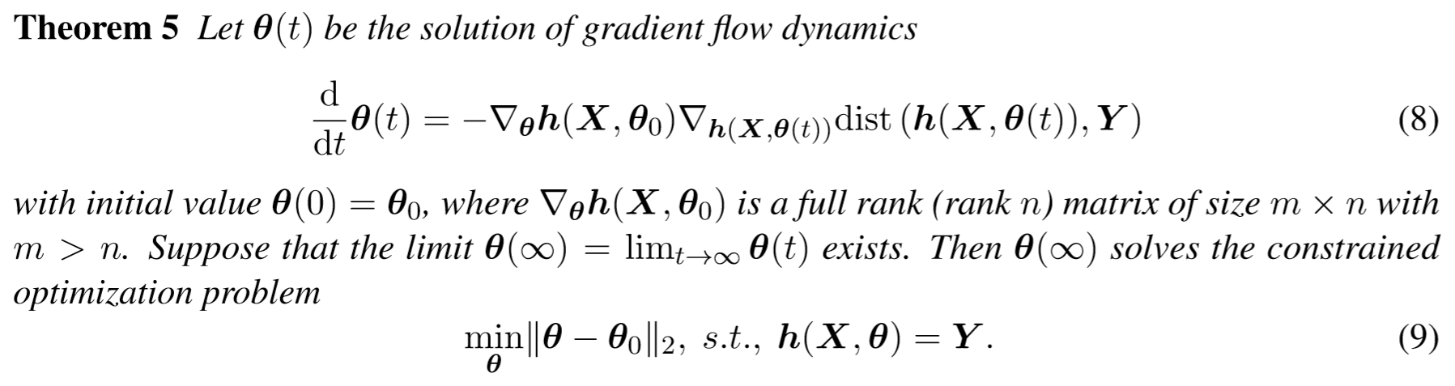

Equivalent optimization problems
In a general class, e.g., any $L^{p}$ distance, choice of loss has no impact.
In practice, different loss can be considered to accelerate convergence.
Yaoyu Zhang, Zhi-Qin John Xu* , Tao Luo, Zheng Ma, A type of generalization error induced by initialization in deep neural networks. arXiv preprint: 1905.07777 (2019), 1st Mathematical and Scientific Machine Learning Conference (MSML2020).

Slide 23
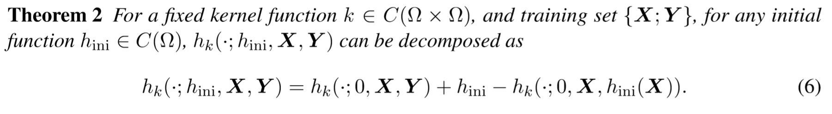
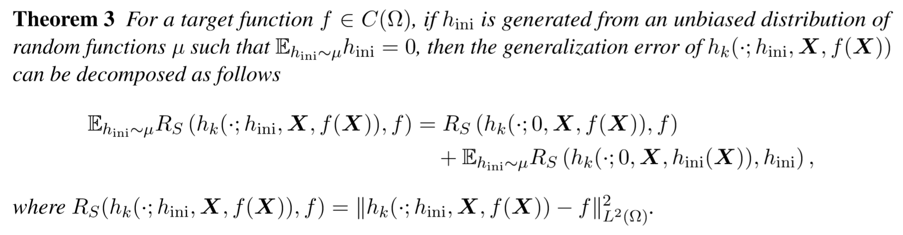
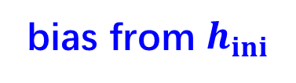
Main results
unbiased fit
bias from $h_{ini}$
additional generalization error
Yaoyu Zhang, Zhi-Qin John Xu* , Tao Luo, Zheng Ma, A type of generalization error induced by initialization in deep neural networks. arXiv preprint: 1905.07777 (2019), 1st Mathematical and Scientific Machine Learning Conference (MSML2020).

Slide 24
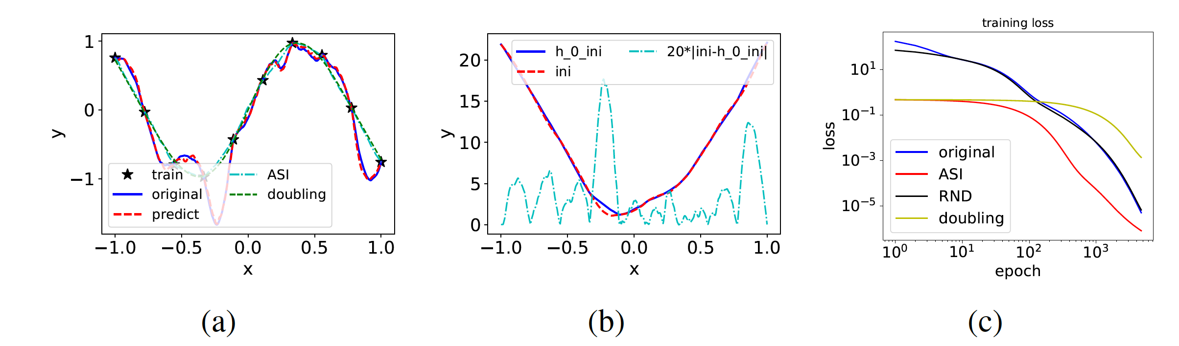
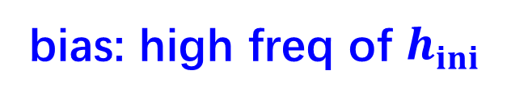
Illustration
$h_{K}\left(⋅;h_{ini}, X,Y\right)−$ $h_{K}\left(⋅;0, X,Y\right)=h_{ini}−h_{K}\left(⋅;0, X,h_{ini}(X)\right)$
bias: high freq of $h_{ini}$
Red: $h_{K}\left(⋅;0, X,Y\right)+h_{ini}−h_{K}\left(⋅;0, X,h_{ini}(X)\right)$
Blue:$h_{K}\left(⋅;h_{ini}, X,Y\right)$
Yaoyu Zhang, Zhi-Qin John Xu* , Tao Luo, Zheng Ma, A type of generalization error induced by initialization in deep neural networks. arXiv preprint: 1905.07777 (2019), 1st Mathematical and Scientific Machine Learning Conference (MSML2020).

Slide 25
Revisit previous experiments
Xu, et al., ICONIP 2019

Slide 26
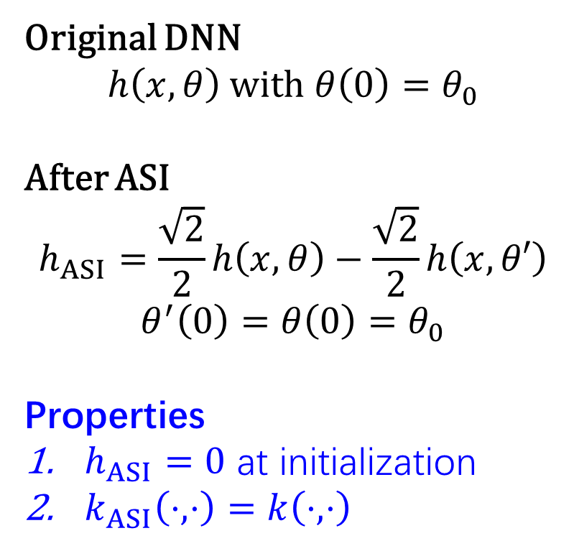
AntiSymmetrical Initialization (ASI) trick
Original DNN
$$h\left(x,θ\right) with θ\left(0\right)=θ_{0}$$
After ASI
$$h_{ASI}=\frac{\sqrt{2}}{2}h\left(x,θ\right)−\frac{\sqrt{2}}{2}h\left(x,θ′\right)$$
$$θ^{′}\left(0\right)=θ\left(0\right)=θ_{0}$$
Properties
$h_{ASI}=0$ at initialization
$k_{ASI}\left(⋅,⋅\right)=k\left(⋅,⋅\right)$
Zero output
Copy weight
opposite weight
Copy weight
Yaoyu Zhang, Zhi-Qin John Xu* , Tao Luo, Zheng Ma, A type of generalization error induced by initialization in deep neural networks. arXiv preprint: 1905.07777 (2019), 1st Mathematical and Scientific Machine Learning Conference (MSML2020).
Notes:
2018 lazy training

Slide 27
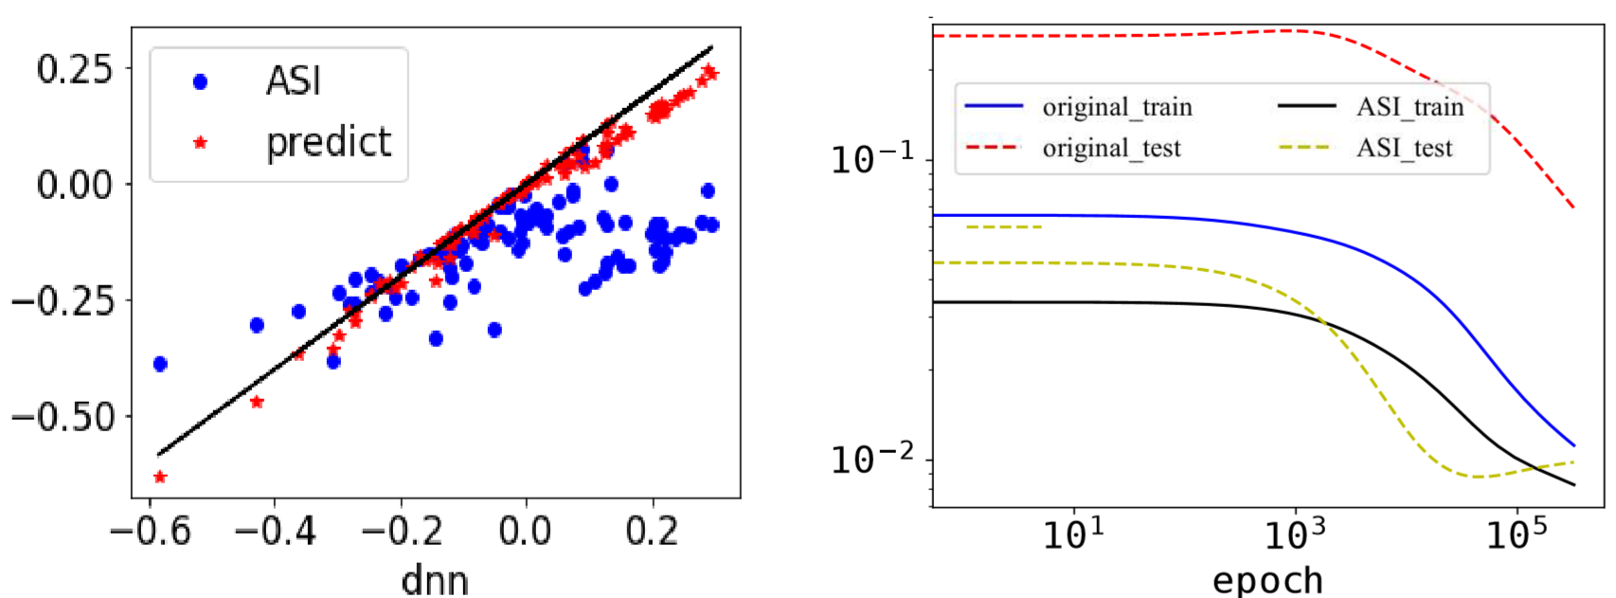
Experiments--Boston house price dataset
Yaoyu Zhang, Zhi-Qin John Xu* , Tao Luo, Zheng Ma, A type of generalization error induced by initialization in deep neural networks. arXiv preprint: 1905.07777 (2019), 1st Mathematical and Scientific Machine Learning Conference (MSML2020).

Slide 28
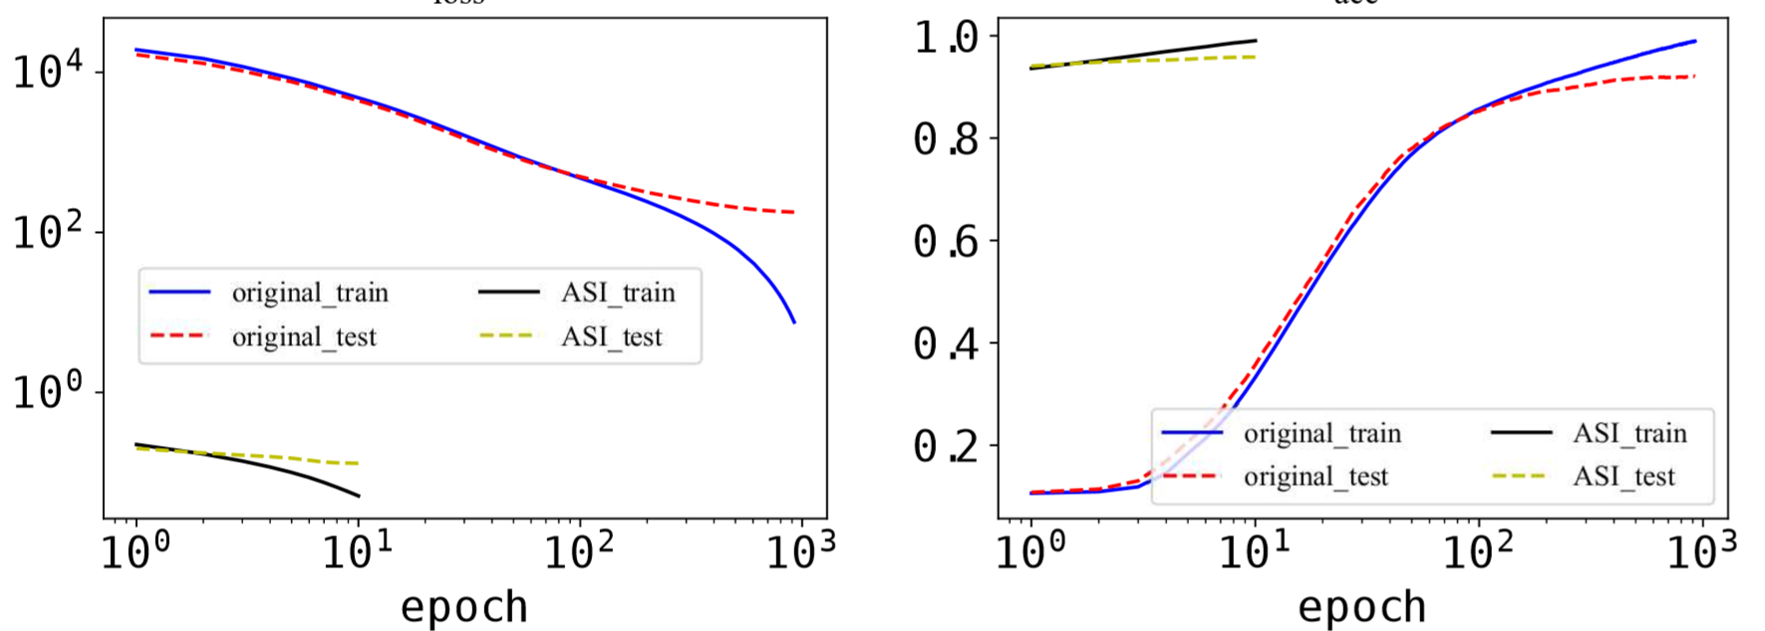
Experiments—MNIST dataset
Yaoyu Zhang, Zhi-Qin John Xu* , Tao Luo, Zheng Ma, A type of generalization error induced by initialization in deep neural networks. arXiv preprint: 1905.07777 (2019), 1st Mathematical and Scientific Machine Learning Conference (MSML2020).

Slide 29
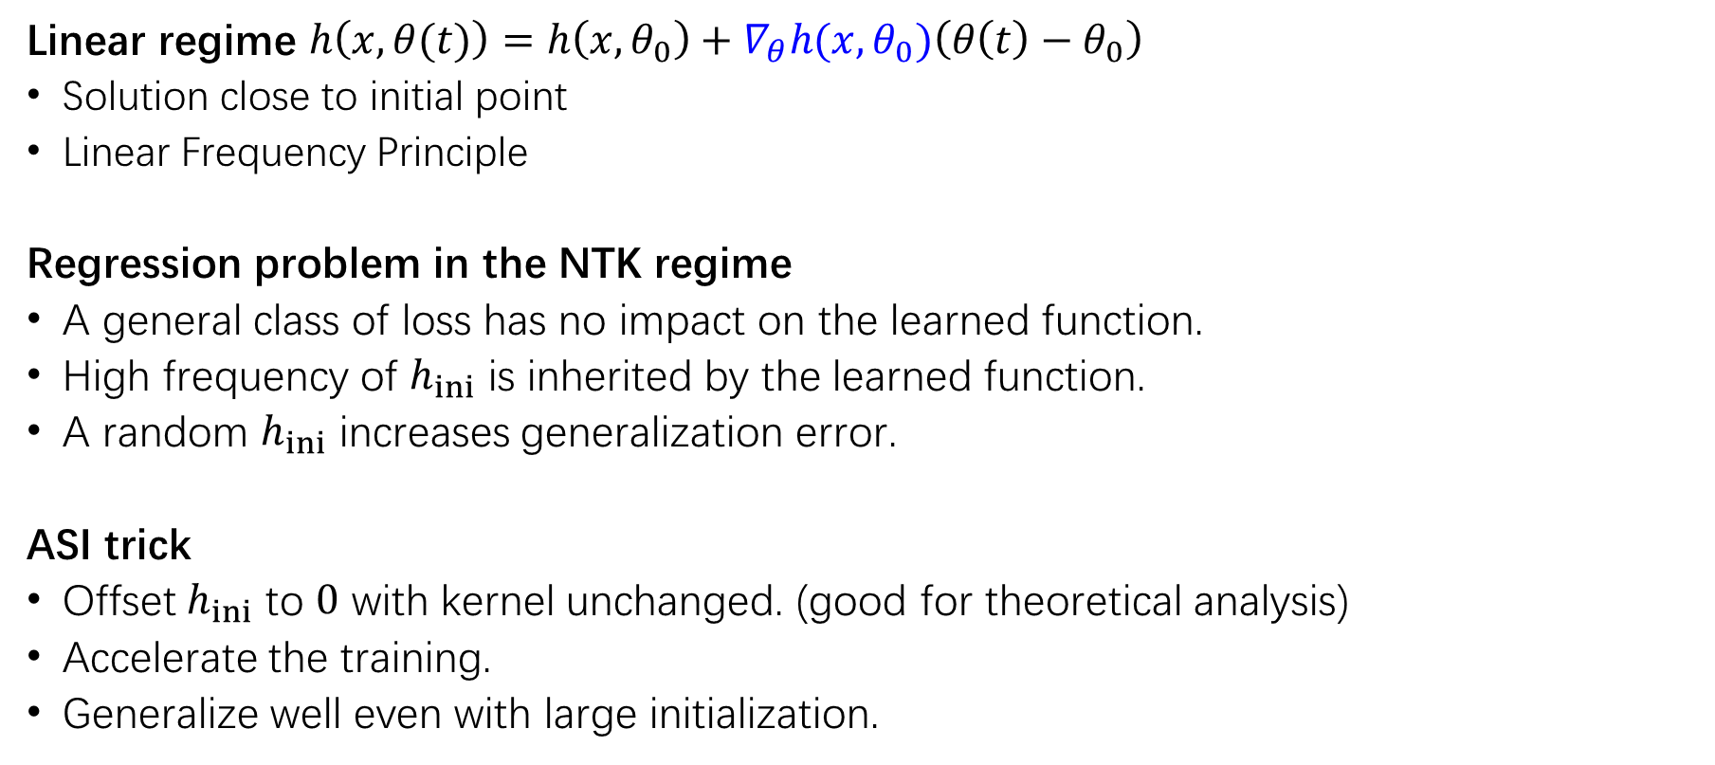
小结
Linear regime $h\left(x, θ(t)\right)=h\left(x,θ_{0}\right)+∇_{θ}h(x,θ_{0})\left(θ\left(t\right)−θ_{0}\right)$
Solution close to initial point
Linear Frequency Principle
Regression problem in the NTK regime
A general class of loss has no impact on the learned function.
High frequency of $h_{ini}$ is inherited by the learned function.
A random $h_{ini}$ increases generalization error.
ASI trick
Offset $h_{ini}$ to $0$ with kernel unchanged. (good for theoretical analysis)
Accelerate the training.
Generalize well even with large initialization.
1 Yaoyu Zhang, Tao Luo, Zheng Ma, Zhi-Qin John Xu*, Linear Frequency Principle Model to Understand the Absence of Overfitting in Neural Networks. Chinese Physics Letters, 2021
2 Tao Luo*, Zheng Ma, Zhi-Qin John Xu, Yaoyu Zhang, On the exact computation of linear frequency principle dynamics and its generalization, SIAM Journal on Mathematics of Data Science (SIMODS 2022), arxiv 2010.08153
3 Tao Luo*, Zheng Ma, Zhiwei Wang, Zhi-Qin John Xu, Yaoyu Zhang, An Upper Limit of Decaying Rate with Respect to Frequency in Deep Neural Network, To appear in Mathematical and Scientific Machine Learning 2022 (MSML22)
4 Yaoyu Zhang, Zhi-Qin John Xu* , Tao Luo, Zheng Ma, A type of generalization error induced by initialization in deep neural networks. arXiv preprint: 1905.07777 (2019), 1st Mathematical and Scientific Machine Learning Conference (MSML2020).

